Slide 1
Definition: DAG
A Directed Acyclic Graph often abbreviated DAG
DAGs used in many applications to indicate precedences among events.
If DFS of a directed graph yields no back edges, then the graph contains no cycles [Lemma 23.10 in text]
A
D
A
D
B
B
G
G
F
C
E
F
C
E
This graph has more than one cycle.
Can you find them all?
This graph has no cycles, so it is a DAG.

Slide 2
Definition: Topological Sort
A topological sort of a DAG G = (V, E) is a linear ordering of all its vertices such that if G contains an edge (u, v), then u appears before v in the ordering.
If the graph is not acyclic, then no linear ordering is possible.
A topological sort of a graph can be viewed as an ordering of its vertices along a horizontal line so that all directed edges go from left to right.
Topological sorting is thus different from the usual kind of "sorting" .

Slide 3
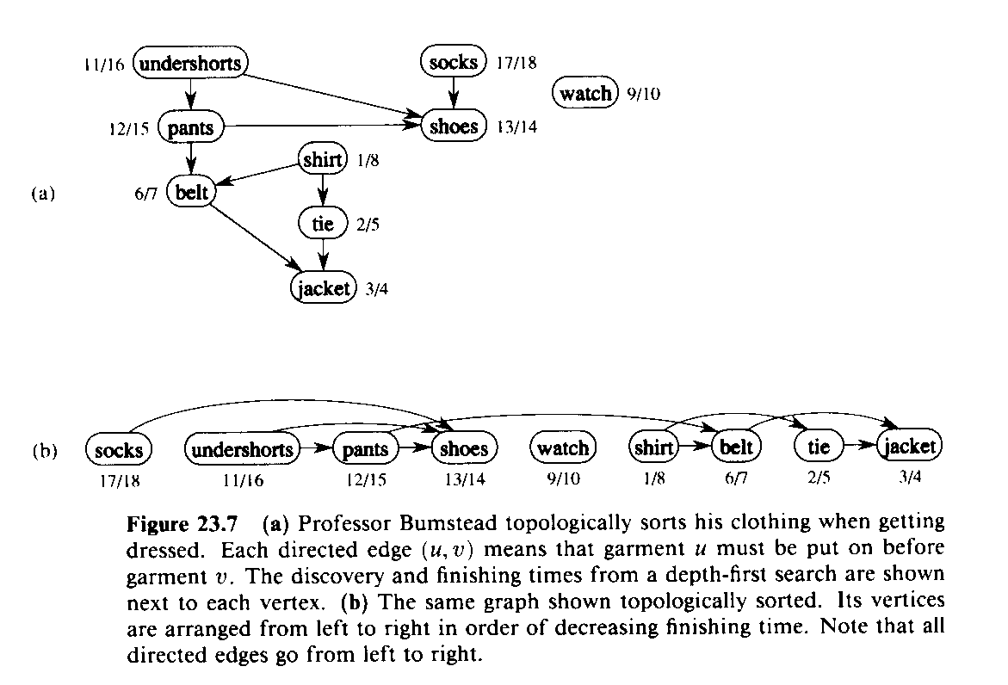
Elementary Graph Algorithms: Topological Sort
for Directed, Acyclic Graph (DAG)
G=(V,E)
TOPOLOGICAL-SORT(G)
1 DFS(G) computes “finishing times” for each vertex
2 as each vertex is finished, insert it onto front of list
3 return list
Produces linear ordering of vertices.
For edge (u,v), u is ordered before v.
source: textbook Cormen et al.

Slide 4
Topological Sort Algorithm
The following algorithm topologically sorts a DAG:
TOPOLOGICAL-SORT(G)
call DFS(G) to compute finishing times f[v] for each vertex v (this is equal to the order in which vertices change color from gray to black)
as each vertex is finished (turns black), insert it onto the front of a linked list
return the linked list of vertices

Slide 5
Example
A
D
For this DAG:
DFS produces this result:
this contains 2 DFS trees
Vertices are blackened in the following order:
C, B, F, A, D, E , G
B
G
F
C
E
A
D
T
C
C
T
T
B
F
T
G
T
F
C
C
E
C

Slide 6
Example
Vertices are added to front of a linked list in the blackening order.
Final result is shown below
Note that all tree edges and non-tree edges point to the right
T
C
T
T
C
T
G
E
D
C
A
B
C
F
T
C
F

Slide 7
Topological Sort
We can perform a topological sort in time Θ(V + E), since depth-first search takes Θ(V + E) time and it takes 0(1) time to insert each of the |V| vertices onto the front of the linked list.

Slide 8
Topological Sort
Theorem 23.11: TOPOLOGICAL-SORT(G) produces a topological sort of a directed acyclic graph G.
Proof: Suppose that DFS is run on a given dag G = (V, E) to determine finishing times for its vertices. It suffices to show that for any pair of distinct vertices u,v Î V, if there is an edge in G from u to v, then f[v] < f[u]. Consider any edge (u,v) explored by DFS(G). When this edge is explored, v cannot be gray, since then v would be an ancestor of u and (u,v) would be a back edge, contradicting Lemma 23.10. Therefore, v must be either white or black. If v is white, it becomes a descendant of u, and so f[v] < f[u]. If v is black, then f[v] < f[u] as well. Thus, for any edge (u,v) in the dag, we have f[v] < f[u], proving the theorem.

Slide 9
DFS application: topological sort
Given DAG, list vertices v₀, v₁, …., v_{n} so that no edges from v_{i} to v_{j} (j < i)
example:
a
d
b
f
c
e
a
b
f
d
e
c

Slide 10
DFS application: topological sort
Theorem: listing vertices in reverse order of DFS finishing times yields a topological sort of DAG G
(can implement in linear time; how?)
Proof: claim for all (u,v) 2 E, v.finish < u.finish
when (u,v) explored, v not grey since then G would have a cycle [back-edge]
v white ) descendent of u so v finishes first
v black ) already done, so v.finish is set and u.finish will be set with a later time

Slide 11
Strongly connected components
say that x » y if there is a directed path from x to y and from y to x in G
equivalence relation, equivalence classes are strongly connected components of G
also, maximal strongly connected subsets
SCC structure is a DAG (why?)

Slide 12
Strongly connected components
DFS tree from v in G: all nodes reachable from v
DFS tree from v in G^{T}: all nodes that can reach v
Key: in sink SCC, this is exactly the SCC
G with edges reversed
v

Slide 13
Strongly connected components
v
given v in a sink SCC, run DFS starting there, then move to next in reverse topological order…
DFS forest would give the SCCs
Key #2: topological ordering consistent with SCC DAG structure! (why?)

Slide 14
Strongly connected components
SCC(directed graph G)
1. run DFS(G)
2. construct G^{T} from G
3. run DFS(G^{T}) but in line 3, consider vertices in decreasing order of finishing times from the first DFS
running time O(n + m) if G in adj. list
note: step 2 can be done in O(m + n) time
trees in DFS forest of the second DFS are the SCCs of G

Slide 15
Strongly connected components
SCC(directed graph G)
1. run DFS(G)
2. construct G^{T} from G
3. run DFS(G^{T}) but in line 3, consider vertices in decreasing order of finishing times from the first DFS
Correctness (sketch):
first vertex is in sink SCC, DFS-VISIT colors black, effectively removes
next unvisited vertex is in sink after removal
and so on…

